Slide 1





DREAM
Soutenance de projet de fin d’études – 09/09/2021 ENSAM Campus de Paris
Oscar Fossey
Design Rules Extractor for Additive Manufacturability
Développement d’un outil d’analyse de description textuelle de produit pour pouvoir assister le concepteur durant la phase de prototypage avec fabrication additive.
Encadrants :
Frédéric Segonds, Maître de Conférences, LCPI, Arts et Métiers
Romain Pinquié, Maître de Conférences, GSCOP, UGA

Slide 2
Sommaire
Problème et objectif du l’outil
Contexte du projet
Problématique de recherche et état de l’art
Conception de l’architecture de l’outil
Développement d’un prototype
Application du prototype sur un cas d’étude
Conclusion et perspectives
Références

Slide 3
Problème et objectif de l’outil

Slide 4
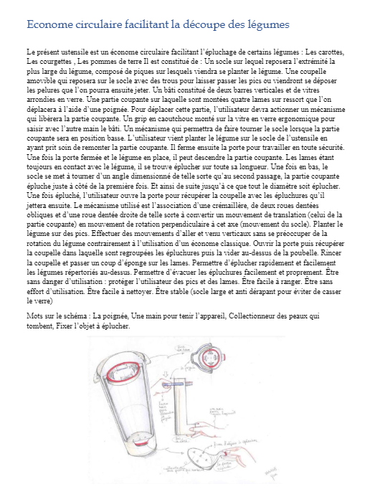

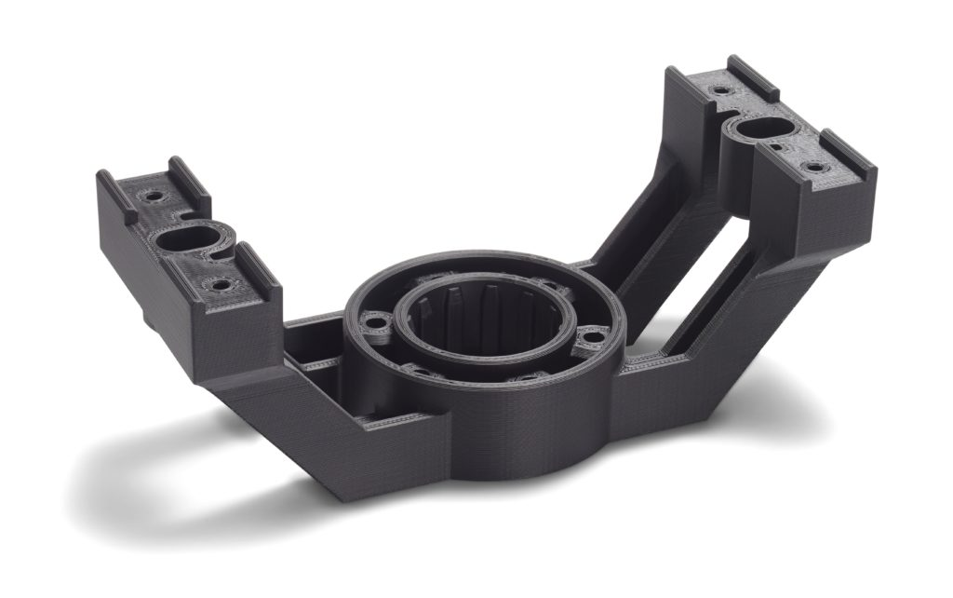

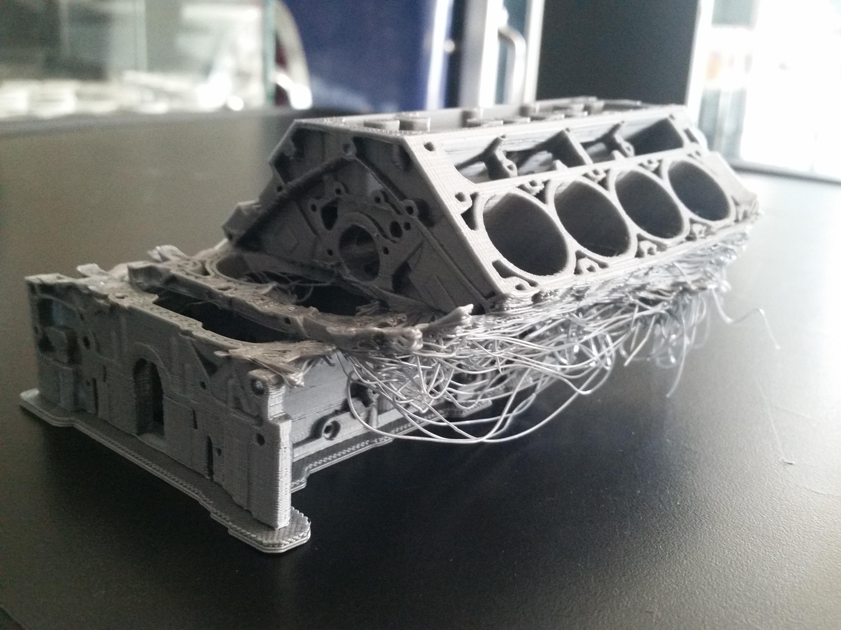
Identification du problème

Slide 5
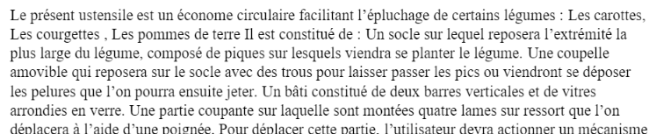
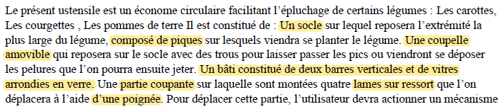
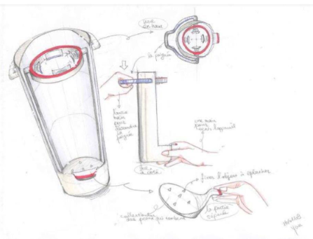

Objectif de l’outil
Outil

Slide 6
Contexte du projet

Slide 7
Contexte du projet
Oscar Fossey : Stagiaire
Frédéric Segonds : Encadrant du projet et tuteur de stage
Romain Pinquié : Encadrant du projet

Slide 8
État de l’art

Slide 9
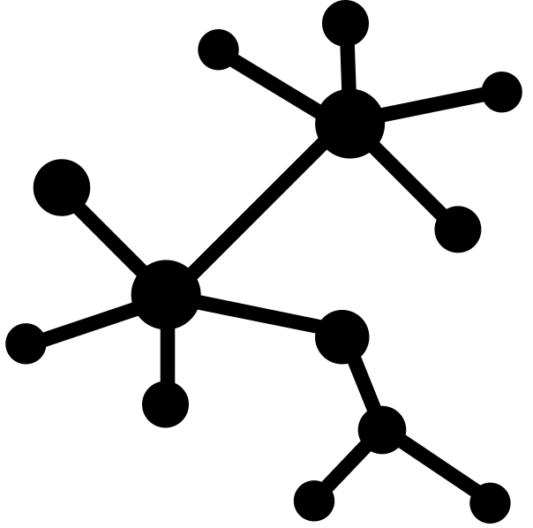
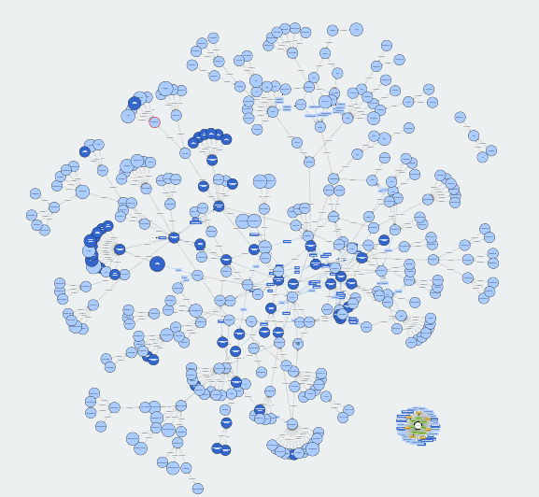


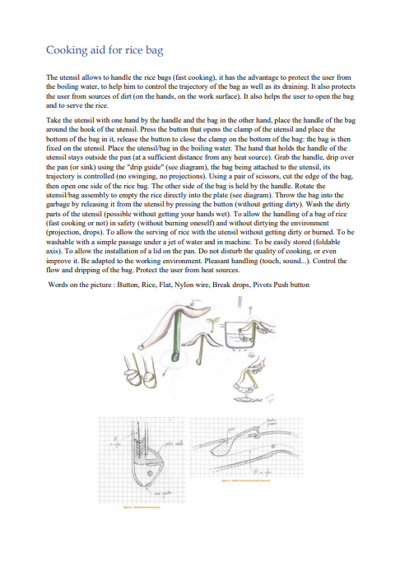


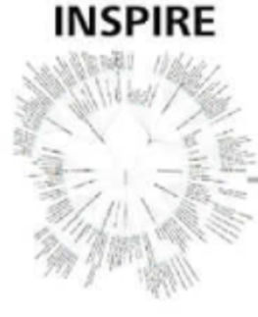



Définition et problématique
Comment utiliser les techniques de traitement et d’analyse de données pour assister le concepteur durant la phase de prototypage avec fabrication additive ?
FA, DFAM,
Prototypage
Ontologies
Analyse de données

Slide 10
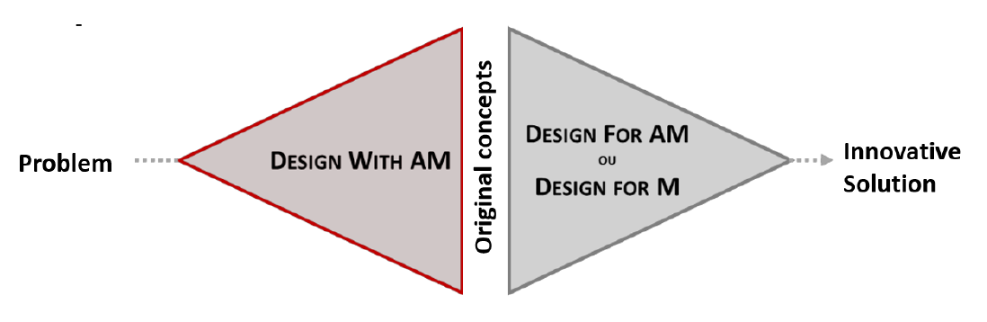
État de l’art : FA, DFAM
FA, DFAM,
Prototypage
Ontologies
Analyse de données
F. Laverne et S. G. Industriel
DFAM (Design for Additive Manufacturing) is a set of methods and tools that help designers consider the specificities of AM (technological, geometrical, etc.) during the design stage [3].
F. Laverne, F. Segonds, N. Anwer, and M. le Coq

Slide 11
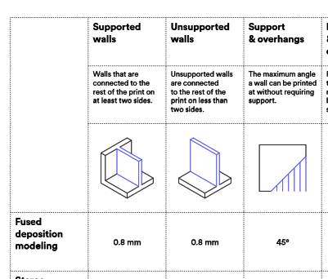
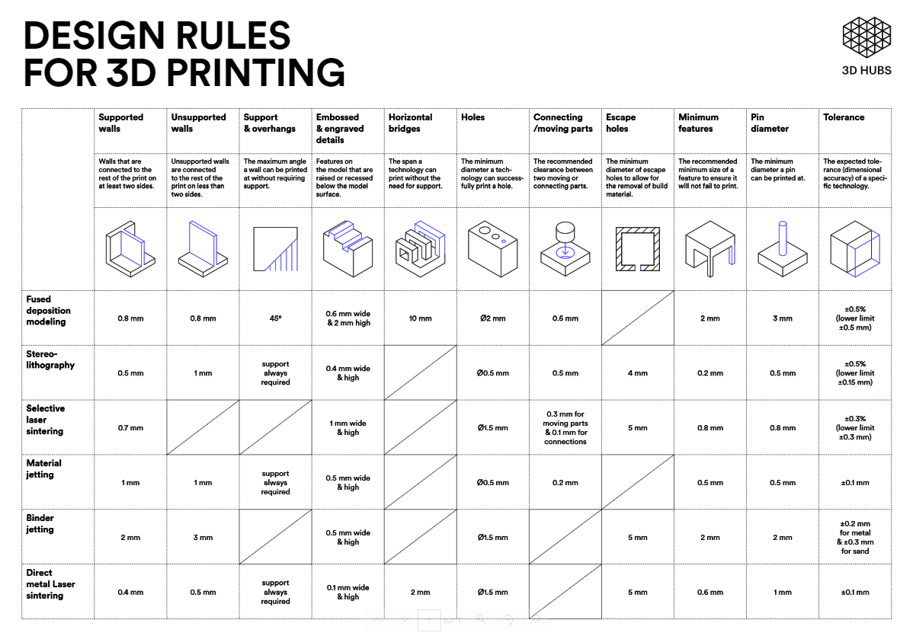
État de l’art : FA, DFAM
FA, DFAM,
Prototypage
Ontologies
Analyse de données
W.-C. Cheung and J. Moultrie

Slide 12
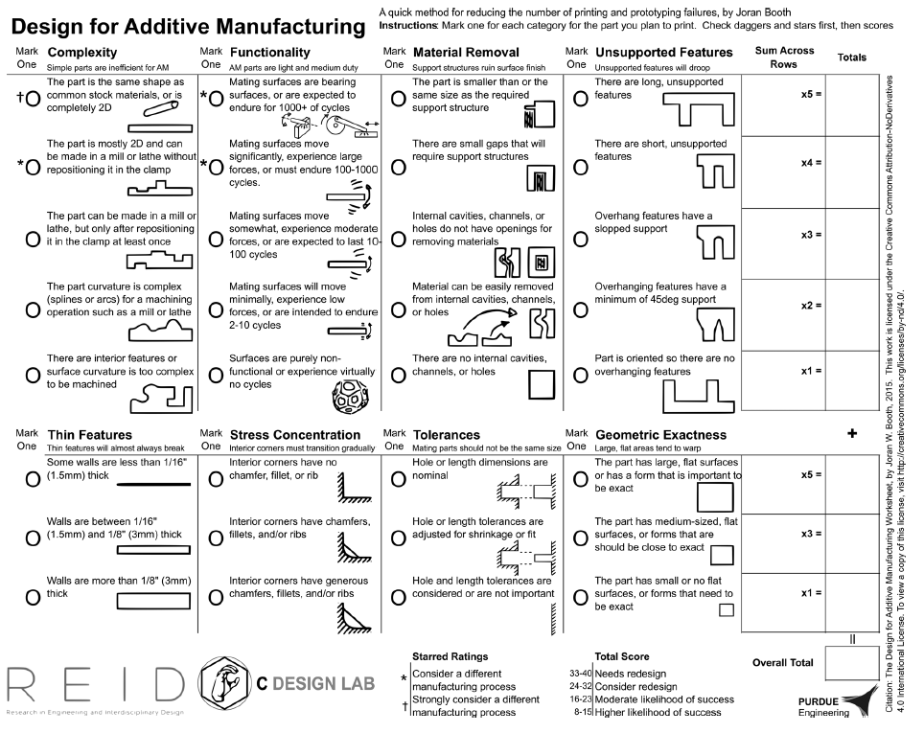
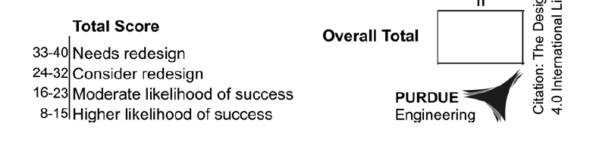
État de l’art : FA, DFAM
FA, DFAM,
Prototypage
Ontologies
Analyse de données
J. W. Booth et al

Slide 13
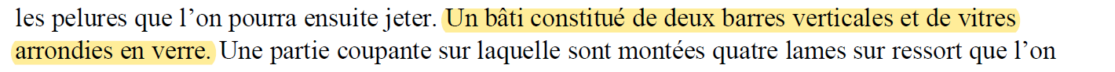

Traitement automatique du langage naturel (NLP)
FA, DFAM,
Prototypage
Ontologies
Analyse de données
Tokenisation
Un
bâti
constitué
de
deux
barres
verticales
bâti
constitué
deux
barres
verticales
Suppression des stop words
Lemmatisation
bâti
constituer
deux
barre
verticale

Slide 14
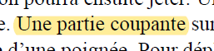
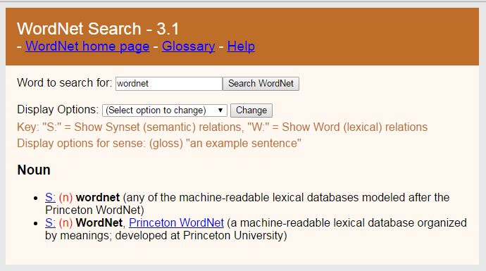
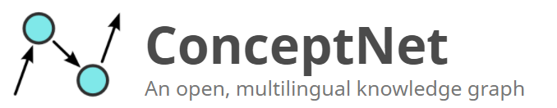

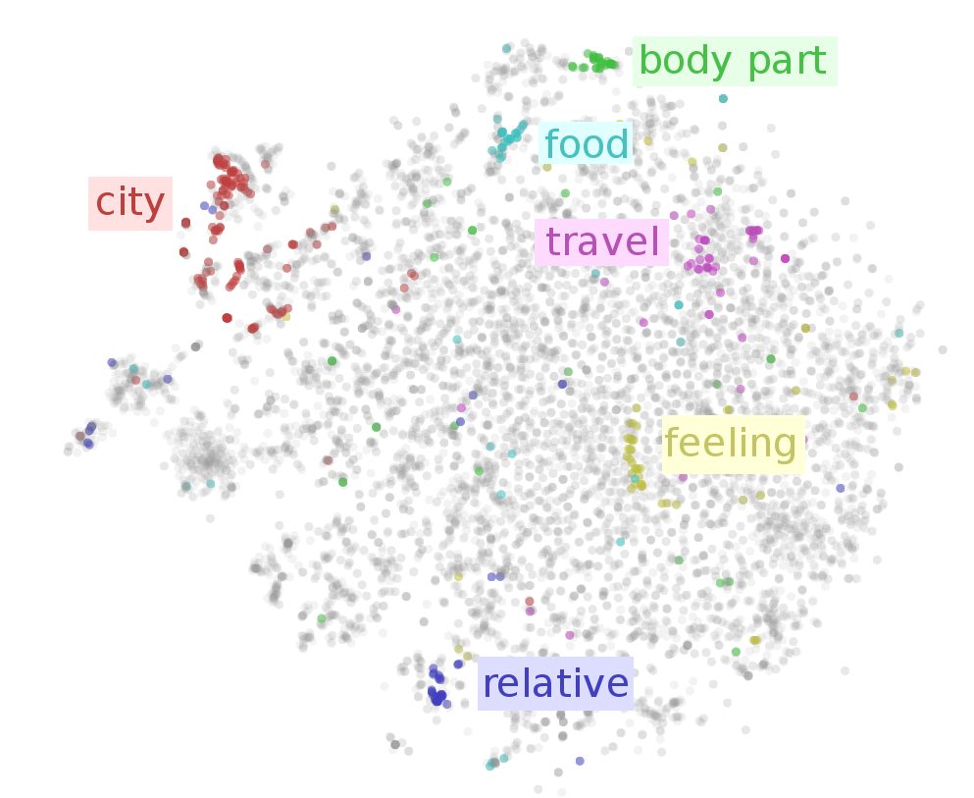



Traitement automatique du langage naturel (NLP)
Analyse sémantique et thesaurus:
FA, DFAM,
Prototypage
Ontologies
Lame
Analyse de données
Métal

Slide 15
Ontologies
Une ontologie est une représentation explicite des concepts d'un domaine d'intérêt, avec leurs caractéristiques et leurs relations
FA, DFAM,
Prototypage
Ontologies
I. Bedini and B. Nguyen
e_beam_B :
Types (classe) : epaisseur
Object property : parametre beam_B
Data property : hasValue 1,33f
Data property : hasUnit « mm »
Analyse de données
épaisseur
minimale
machine
EstControlePar
Classes and subclasses
Object properties
Data properties
Data types
S. Kim, D. W. Rosen, P. Witherell, and H. Ko
Individuals
Owlready2

Slide 16
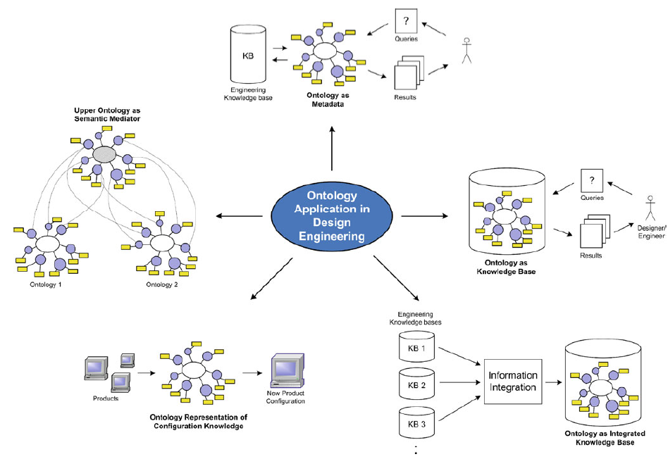
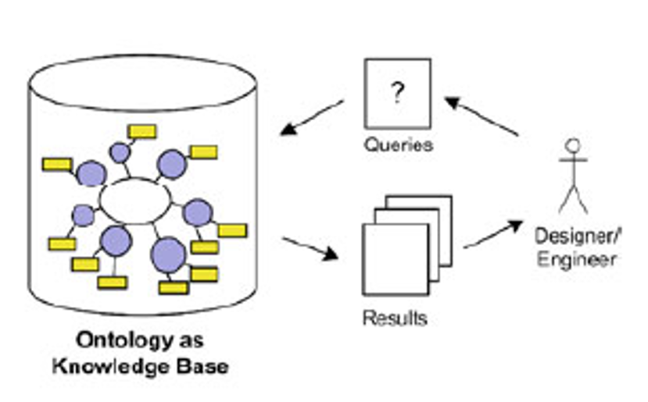
Ontologies
Y. Liu and S.C.J. Lim

Slide 17
Conception de l’architecture de l’outil

Slide 18
Listes des règles de conception
Are the rectangular or circular bars too thin? | [1] : 2mm (circular) 3mm (recangular)
Is the part completly 2D? [3]
Is the part mainly 2D and can be maid in a mill or lathe without repositionning the clamp? [3]
Is the part can be made made in a mill or lathe, but only after repositioning it in the clamp at leats once? [3]
Does the part have complex splines or arcs for a machine operations such as a mill or lathe ? [3]
Does the part has interior features or surfaces curvature are to complex to be machined? [3]
Does mating surfaces are bearing surfaces or are expected to endure for 1000+ of cycles? [3]
Does Mating surfaces move significantly, experience large forces or must endure 100-1000 cycles? [3] | [5] : 40 Mpa flexion / 20 Mpa in traction
Does mating surfaces move somewhat, experience moderate forces , or are expected to last 10-100cycles? [3] | [5] : less than 5MPa overall
Does surfaces are purely non-fonctional or experience virtually no cycles ? [3]
Does the part is smaller than or the same size as the required support structure ? [3]
Will there be small gaps that will require strutures ? [3]
Will it be difficult to remove unwanted materials from the internal geometries ? [3]
Will there be any internal cavities or channels or holes on the part ? [3]
Will there be long unsupported features ? [3] | [1] : 5-10mm
Will there be short unsupported features ? [3] | [1] : 1-5mm
Will Overhang features have a slopped support or a 45deg support ? [3]
Will there be small holes? | [1] : 2mm of diameter
Will the part be lightly embossed or chamfered ? [3]
Will the part be strongly embossed or chamfered ? [3]
Will the parts have to fit together perfectly ? [3] | [1] : more or less of 0,5% / [2] : xy : Entre 11et 13 z: 11 et 14 (ISO 286-1)
Does Hole or lentgh tolerances are adjusted for shrinkage or fit ? [3]
Is there no tolerance in terms of the dimensions of the part? | [1] : At leat 0,5 mm between two parts meant to fit together
Does the part will have large flat surfaces? Does it needs an exact flatness ? [3]
Will there be any flat surfaces that need to have almost exact flatness ? [3]
Does the part need to have a low surface rougness ? | [4] : Lowest 20 microns for a plane end 40microns for a 45° surface
Are the thinner planes too thin ? | [1] : 0,8mm
Will there be any engraving or work on the surface wich will be to precise ? | [1] : 0,6mm width and 2mm high
Are the rectangular or circular bars too thin? | [1] : 2mm (circular) 3mm (recangular)
Will the part be made of plastic ?
Will the part be made of metal or ceramic ?
30 règles de conceptions sous forme de question fermée
5 sources scientifique sur la DFAM différentes
Utilisation du procédé Fused Deposition Modeling (FDM) pour choisir les critères quantitatifs
Conditions de l’évaluation manuelle :
Résultats de l’évaluation manuelle :
10 fiches idées du projet Karis réalisé au LCPI
2 sources d’informations possible : texte et schéma/croquis
30 questions fermés par grille de critère (300 questions en tout)
3 réponses possible par questions 1 : 0 : Na
46% des réponses ont été trouvées avec des données du texte
51% des réponses ont été trouvées avec des données du schéma
12% des questions n’ont pas trouvées de réponse

Slide 19

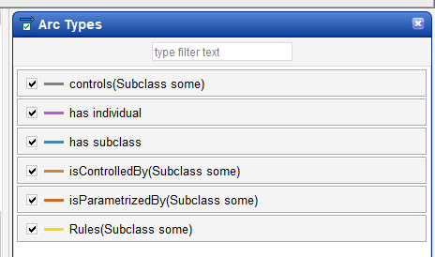
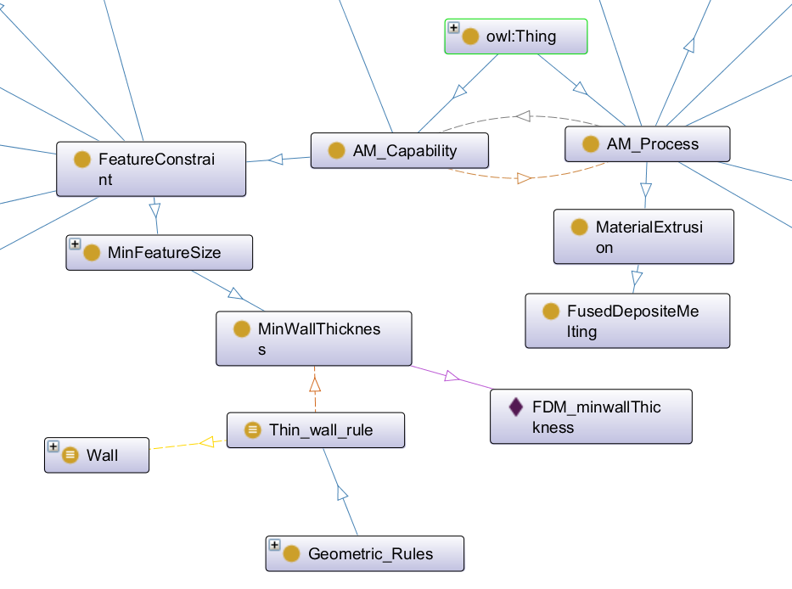
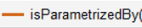
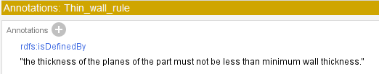
Intégration des règles dans l’ontologie

Slide 20
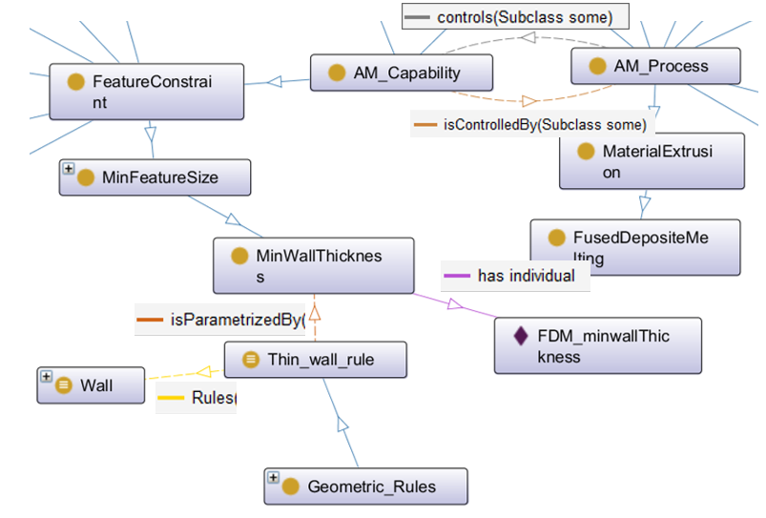
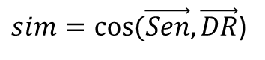
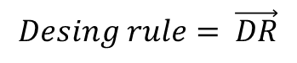
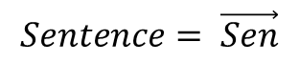
Enrichissement sémantique et étude de similarité
Expanded representation of the sentence
Idea card
Bag of Words
THIN
CUCUMBER
PLANES
FORM
GLASS
LIQUID
JUICE
SHAPE
VEGETEBAL
WALL
$$Sentence= \vec{Sen}$$
Expanded representation of the AM design rule
DFAM ontology
$sim=cos⁡(\vec{Sen},\vec{DR}$)
RECTANGULAR
BARS
THIN
SLIM
EDGE
Design rules set
BEAM
FORM
ROUND
MINIMUM
$$Desing rule= \vec{DR}$$
Are the rectangular or circular bars too thin?
DFAM ontology
DFAM ontology

Slide 21
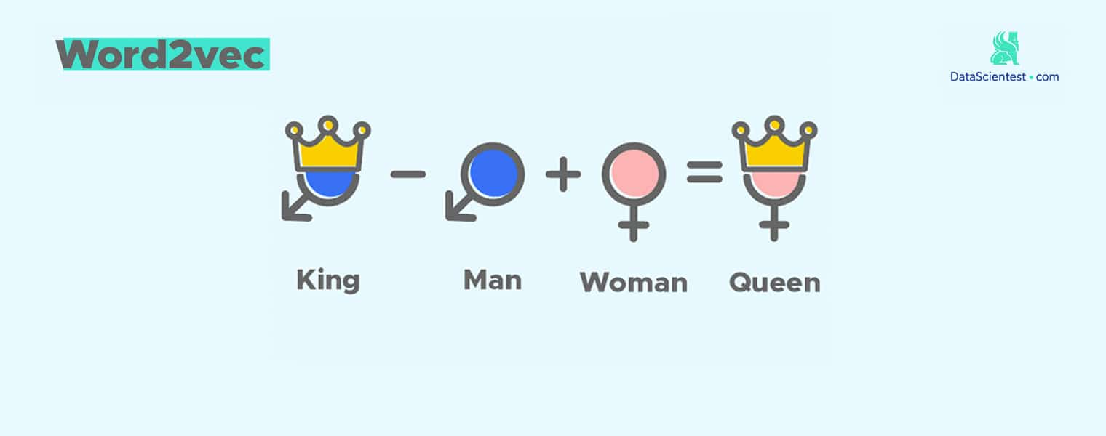
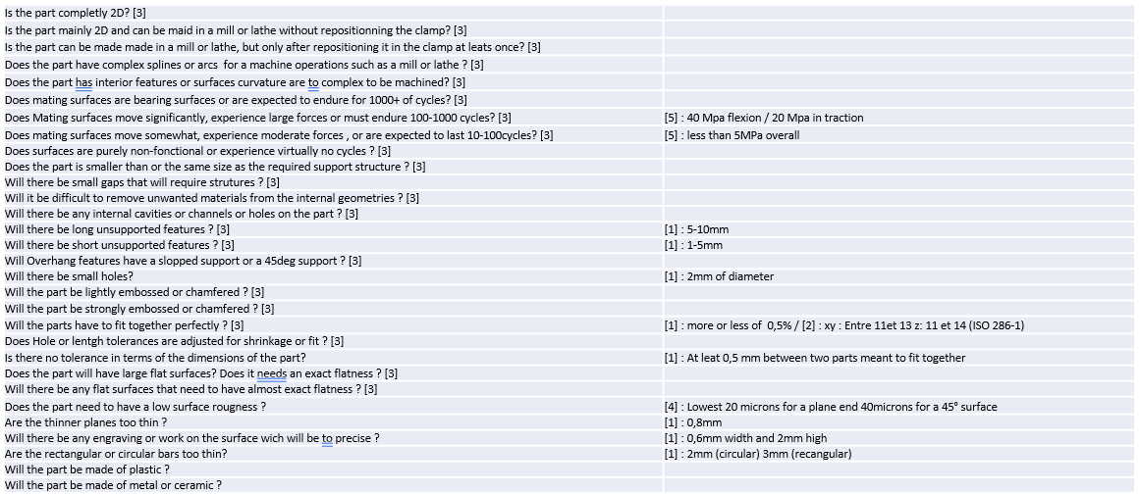

Architecture global de l’outil DREAM
Outil DREAM
Fiche idée
Rapport d’analyse de fabricabilité (FA)
Analyse sémantique
Recommandation de règles de conception FA
Étude de similarité
Règles de Conception
Implementation dans l’ontologie DFAM
Analyse sémantique
Owlready2
Design Rules Extractor for Additive Manufacturability

Slide 22
Développement d’un prototype

Slide 23
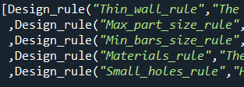
Développement du prototype
Thin_wall_rule : The thickness of the walls of the part must not be less than 0.8.
Max_part_size_rule : The overall length of the full size should be less than 1000.
Min_bars_size_rule: A circular bar must be larger than 2 and a rectangular bar must be larger than 3.
Materials_rule: The prototype should be functional with only plastic or polymer features, any other materials cannot be used.
Small_holes_rule : Holes made on the part should not be too small, minimum 2 of diameter.

Slide 24
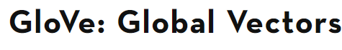
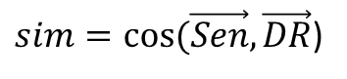
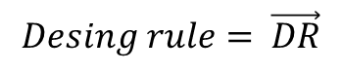
Enrichissement sémantique et étude de similarité
Expanded representation of the sentence
Idea card
Bag of Words
THIN
CUCUMBER
PLANES
FORM
GLASS
LIQUID
WALL, SHAPE, VEGETEBAL, JUICE
$$Sentence= \vec{Sen}$$
$sim=cos⁡(\vec{Sen},\vec{DR}$)
SLIM
EDGE
Reduced set of AM design rules
BEAM
FORM
ROUND
MINIMUM
Are the rectangular or circular bars too thin?
$$Desing rule= \vec{DR}$$

Slide 25

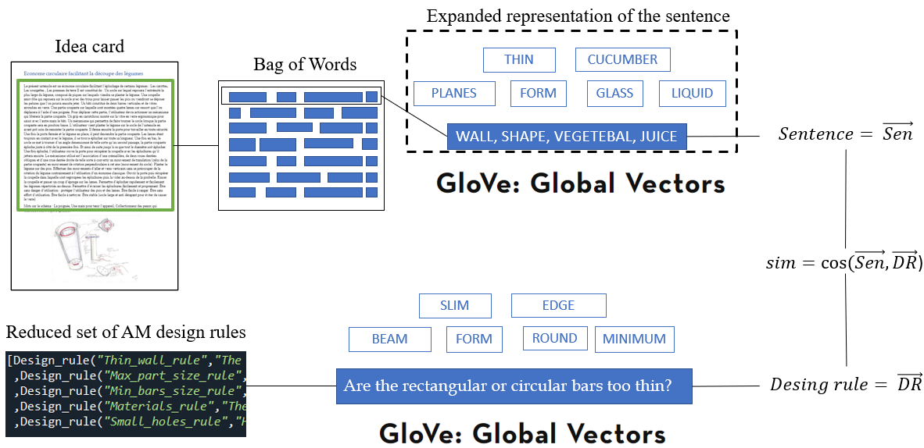
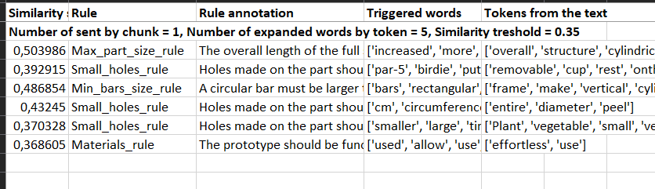

Flux d’entré et de sortie
.txt

Slide 26
Application sur un cas d’étude

Slide 27
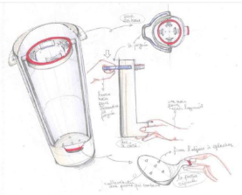
Cas d’étude
“This utensil is a circular peeler facilitating the peeling of certain vegetables: Carrots, cucumber, potatoes. The overall structure is cylindrical, the size is about 25 cm high, to allow the most classic vegetables to pass through. It consists of: A base on which will rest the widest end of the vegetable, composed of sharp spikes on which will be planted the vegetable. A removable cup which will rest on the base with small holes to let pass the spikes or will come to deposit the peels which one will be able to throw then. A frame made of two vertical cylindrical bars and rounded glass panes. A cutting part on which are mounted four spring-loaded steel blades that can be moved with a handle. To move this part, the user will have to activate a mechanism that will release the cutting part. A rubber grip mounted on the ergonomic glass window to grasp the frame with the other hand. A mechanism that will allow the base to rotate when the cutting part is in the down position. The user plants the vegetable on the base of the utensil having taken care to raise the cutting part. He then closes the door to work safely. Once the door is closed and the vegetable is in place, he can lower the cutting part. The steel blades being still in contact with the vegetable, it is peeled on all its length. Once at the bottom, the base starts to rotate at an angle so that on the second pass, the cutting part peels right next to the first. And so on until the entire diameter is peeled. Once peeled, the user opens the door to recover the cup with the peelings that he will then throw away. The mechanism used is the association of a rack, two oblique toothed wheels and a straight toothed wheel in such a way as to convert a translation movement (that of the cutting part) into a rotation movement perpendicular to this axis (movement of the base). Plant the vegetable on small vertical spikes. Move the vegetable back and forth vertically without worrying about the rotation of the vegetable as opposed to using a classic peeler. Open the door and retrieve the cup in which the peelings are grouped, then empty it over the garbage can. Rinse the cup and wipe the steel blades with a sponge. Allow for quick and easy peeling of the vegetables listed above. Allow for easy and clean disposal of peels. Be safe to use protect the user from spikes and steel blades. Easy to store. Effortless to use. Easy to clean. Be stable (wide base and anti-slip to avoid breaking the glass). Words on the picture: The handle, one hand to hold the device, collecting the falling skins, fixing the object to be peeled.”

Slide 28
Rule : Max_part_size_rule
Similarity score : 0,503986
Rule annotation : The overall length of the part full size should be less than 1000.
“This utensil is a circular peeler facilitating the peeling of certain vegetables: Carrots, cucumber, potatoes. The overall structure is cylindrical, the size is about 25 cm high, to allow the most classic vegetables to pass through. It consists of: A base on which will rest the widest end of the vegetable, composed of sharp spikes on which will be planted the vegetable. A removable cup which will rest on the base with small holes to let pass the spikes or will come to deposit the peels which one will be able to throw then. A frame made of two vertical cylindrical bars and rounded glass panes. A cutting part on which are mounted four spring-loaded steel blades that can be moved with a handle. To move this part, the user will have to activate a mechanism that will release the cutting part. A rubber grip mounted on the ergonomic glass window to grasp the frame with the other hand. A mechanism that will allow the base to rotate when the cutting part is in the down position. The user plants the vegetable on the base of the utensil having taken care to raise the cutting part. He then closes the door to work safely. Once the door is closed and the vegetable is in place, he can lower the cutting part. The steel blades being still in contact with the vegetable, it is peeled on all its length. Once at the bottom, the base starts to rotate at an angle so that on the second pass, the cutting part peels right next to the first. And so on until the entire diameter is peeled. Once peeled, the user opens the door to recover the cup with the peelings that he will then throw away. The mechanism used is the association of a rack, two oblique toothed wheels and a straight toothed wheel in such a way as to convert a translation movement (that of the cutting part) into a rotation movement perpendicular to this axis (movement of the base). Plant the vegetable on small vertical spikes. Move the vegetable back and forth vertically without worrying about the rotation of the vegetable as opposed to using a classic peeler. Open the door and retrieve the cup in which the peelings are grouped, then empty it over the garbage can. Rinse the cup and wipe the steel blades with a sponge. Allow for quick and easy peeling of the vegetables listed above. Allow for easy and clean disposal of peels. Be safe to use protect the user from spikes and steel blades. Easy to store. Effortless to use. Easy to clean. Be stable (wide base and anti-slip to avoid breaking the glass). Words on the picture: The handle, one hand to hold the device, collecting the falling skins, fixing the object to be peeled.”
Rule : Small_holes_rule
Similarity score : 0,392915
Rule annotation : Holes made on the part should not be too small, minimum 2 of diameter.
Rule : Min_bars_size_rule
Similarity score : 0,486854
Rule annotation : A circular bar must be larger than 2 and a rectangular bar must be larger than 3.
Rule : Small_holes_rule
Similarity score : 0,43245
Rule annotation : Holes made on the part should not be too small, minimum 2 of diameter.
Rule : Small_holes_rule
Similarity score : 0,370328
Rule annotation : Holes made on the part should not be too small, minimum 2 of diameter.
Rule : Materials_rule
Similarity score : 0,368605
Rule annotation : The prototype should be functional with only plastic or polymer features any other materials can not be used.

Slide 29
Conclusion et perspectives

Slide 30
Discussion
Le prototype est capables d’associer des règles de conception et des extrait de texte pertinemment cependant des faux positifs et des faux négatifs sont toujours présent
L’outil permet de traiter un grand nombre de fiche idée sans l’intervention d’un expert
Le développement de l’analyse des schémas est nécessaire pour finaliser l’outil
Intégrer dans l’outil une ontologie possédant les connaissances associées aux opportunités de la FA
Associer à la bonne ontologie, cet outil pourrais s’appliquer aux règles d’écoconception

Slide 31
Références
Laverne, F., Segonds, F, D’Antonio, G., & Le Coq, M. (2016). Enriching design with X through tailored additive manufacturing knowledge: a methodological proposal. International Journal on Interactive Design and Manufacturing (IJIDeM), 11(2), 279-288. doi: https://doi.org/10.1007/s12008-016-0314-7. http://hdl.handle.net/10985/12215
Laverne, F., Segonds, F., Anwer, N., & Le Coq, M. (2015). Assembly based methods to support product innovation in Design for Additive Manufacturing: An exploratory case study. Journal of Mechanical Design, 137(12), 8. doi: https://doi.org/10.1115/1.4031589. http://hdl.handle.net/10985/10380
W.-C. Cheung and J. Moultrie, “3D Printing Design Rules,” p. 6, 2013.
J. W. Booth, J. Alperovich, P. Chawla, J. Ma, T. N. Reid, and K. Ramani, “The design for additive manufacturing worksheet,” Journal of Mechanical Design, Transactions of the ASME, vol. 139, no. 10, pp. 1–9, 2017, doi: 10.1115/1.4037251.
S. Kim, D. W. Rosen, P. Witherell, and H. Ko, “A Design for Additive Manufacturing Ontology to Support Manufacturability Analysis,” Journal of Computing and Information Science in Engineering, vol. 19, no. 4, pp. 1–10, 2019, doi: 10.1115/1.4043531.
Y. Liu and S. C. J. Lim, “Global Product Development,” Global Product Development, pp. 427–433, 2011, doi: 10.1007/978-3-642-15973-2.

Slide 32
Calcule de similarité
« The airplane should be verify every week »
« The aircraft has to be check each week »
[airplane, should, be, verify, every, week]
[aircfraft, have, be, check, each, week]
[airplane, aircfraft, plane, should, must, be, verify, check, look, every, all, week, day]
[aircfraft, plane, airplane, have, own, check, verify, each, one, week, day]
Dictionnaire : [airplane, aircraft, plane, should, must, be, verify, check, look, every, all, week, day, aircfraft, plane, airplane, have, own, check, verify, each, one, week, day]
Phrase 1 : [1, 1, 1, 1, 1, 1, 1, 1, 1, 1, 1, 1, 1,
1, 1, 1, 0, 0, 1, 1, 0, 0, 1, 1]
Phrase 2 : [1, 1, 1, 0, 0, 0, 1, 1, 0, 0, 0, 1, 1,
1, 1, 1, 1, 1, 1, 1, 1, 1, 1, 1]
$sim=cos⁡(\vec{Phrase1},\vec{Phrase2}$) $=\frac{\vec{Phrase1}∙\vec{Phrase2}}{\left\|\vec{Phrase1}\right\|\left\|\vec{Phrase2}\right\|}=\frac{14}{\sqrt{20}\sqrt{18}}$ = 0,738

Slide 33
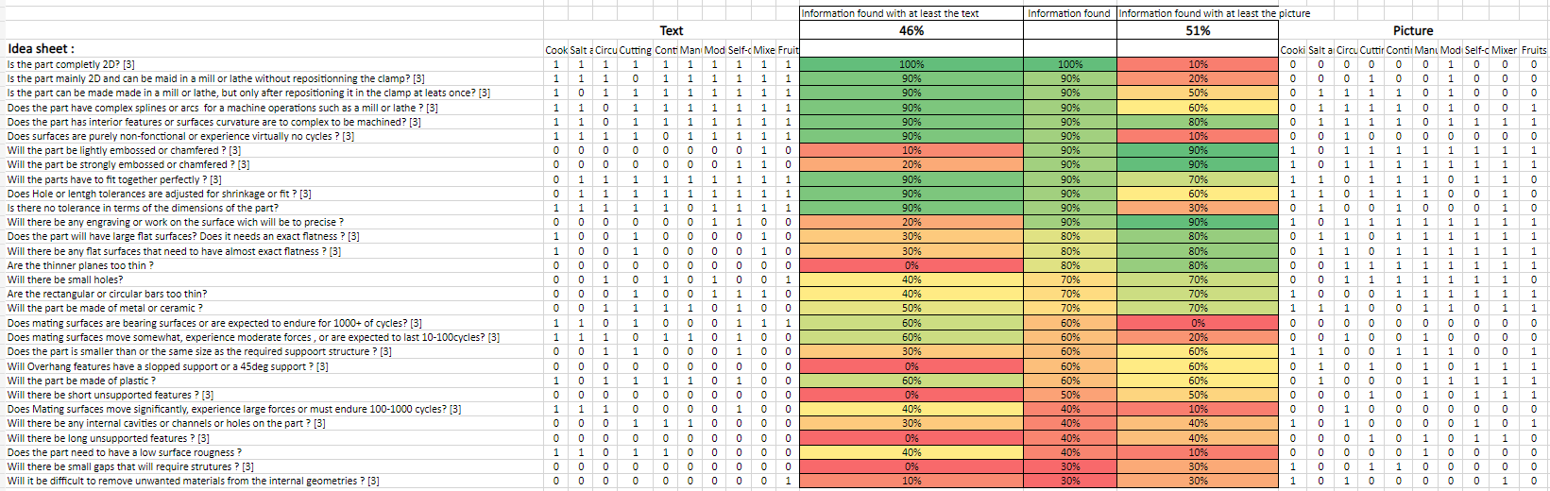

Slide 34
Number of sent by chunk = 1, Number of expanded words by token = 5, Similarity treshold = 0.35
0,503986 | Max_part_size_rule | The overall length of the full size should be less than 1000 | ['increased', 'more', 'smaller', 'sizes', 'third', 'large', 'improved', 'overall', 'increase', 'size', 'larger', 'diameter', 'sized', 'fourth'] | ['overall', 'structure', 'cylindrical', 'size', 'cm', 'high', 'allow', 'most', 'classic', 'vegetable', 'pass']
0,392915 | Small_holes_rule | Holes made on the part should not be too small, minimum 2 of diameter | ['par-5', 'birdie', 'putt', 'holes', 'smaller', 'large', 'hole', 'tiny', 'par-4', 'few', 'larger', 'small'] | ['removable', 'cup', 'rest', 'onthe', 'base', 'small', 'hole', 'let', 'pass', 'spike', 'come', 'deposit', 'peel', 'able', 'throw']
0,486854 | Min_bars_size_rule | A circular bar must be larger than 2 and a rectangular bar must be larger than 3 | ['bars', 'rectangular', 'cylindrical', 'lounge', 'cafe', 'pub', 'restaurant', 'diameter', 'bar'] | ['frame', 'make', 'vertical', 'cylindrical', 'bar', 'round', 'glass', 'pane']
0,43245 | Small_holes_rule | Holes made on the part should not be too small, minimum 2 of diameter | ['cm', 'circumference', 'cylindrical', 'diameters', 'width', 'diameter'] | ['entire', 'diameter', 'peel']
0,370328 | Small_holes_rule | Holes made on the part should not be too small, minimum 2 of diameter | ['smaller', 'large', 'tiny', 'few', 'larger', 'small'] | ['Plant', 'vegetable', 'small', 'vertical', 'spike']
0,368605 | Materials_rule | The prototype should be functional with only plastic or polymer features, any other materials can not be used. | ['used', 'allow', 'use', 'using', 'uses'] | ['effortless', 'use']

